Slide 1
Software Analysis and Design (CS:324) Class Diagram (CD)
Course Instructor: Romasha Khurshid
Email Address: Romasha.Khurshid@nu.edu.pk
Reference Book: Applying UML and Patterns (An introduction to Object-Oriented Analysis and Design And Iterative Development)
BY Craig Larman
Third Edition

Slide 2













Classes
A class is a description of a set of objects that share the same attributes, operations, relationships, and semantics.
Graphically, a class is rendered as a rectangle, usually including its name, attributes, and operations in separate, designated compartments.
ClassName
attributes
operations

Slide 3




Class Names
ClassName
attributes
operations
The name of the class is the only required tag in the graphical representation of a class. It always appears in the top-most compartment.

Slide 4














Class Attributes
Person
name : String address : Address birthdate : Date ssn : Id
An attribute is a named property of a
class that describes the object being modeled.
In the class diagram, attributes appear in the second compartment just below the name-compartment.

Slide 5














Class Attributes (Cont’d)
Attributes are usually listed in the form:
attributeName : Type
A derived attribute is one that can be computed from other attributes, but doesn’t actually exist. For example,
a Person’s age can be computed from his birth date. A derived attribute is designated by a preceding ‘/’ as in:
/ age : Date
Person
name : String address : Address birthdate : Date / age : Date ssn : Id

Slide 6











Class Attributes (Cont’d)
Person
+ name : String # address : Address # birthdate : Date / age : Date - ssn : Id
Attributes can be:
+ public
# protected
- private
/ derived

Slide 7







Class Operations
Person
name : String address : Address birthdate : Date ssn : Id
eat sleep work play
Operations describe the class behavior and appear in the third compartment.

Slide 8






Relationships
In UML, object interconnections (logical or physical), are modeled as relationships.
There are three kinds of relationships in UML:
dependencies
generalizations
associations

Slide 9










Generalization Relationships
Person
A generalization connects a subclass to its superclass. It denotes an inheritance of attributes and behavior
from the superclass to the subclass and indicates a specialization in the subclass of the more general superclass.
Student

Slide 10


Generalization Relationships
UML permits a class to inherit from multiple superclasses, although some programming languages (e.g., Java) do not permit multiple inheritance.
Student
Employee
TeachingAssistant

Slide 11



Dependency Relationships
A dependency indicates a semantic relationship between two or
more elements. The dependency from CourseSchedule to Course exists because Course is used in both the add and remove operations of CourseSchedule
CourseSchedule
Course
add(c : Course) remove(c : Course)
public class CourseSchedule{
Public void updateCourse(Course CourseCode)
{ string New_Course_Code=CourseCode.getCode();}}

Slide 12
Association Relationships
If two classes in a model need to communicate with each other, there must be link between them.
An association denotes that link.
Student |  | Sports

Slide 13
Association Relationships
The multiplicity is an indication of how many objects may participate in the given relationship
Student |  | Sports
 | 1..*
We can indicate the multiplicity of an association by adding multiplicity adornments to the line denoting the association.

Slide 14
Association Relationships
Student |  | Sports
 | 1..* 1..*

Slide 15








Association Relationships
We can specify dual associations.
Student |  | Team
 | ^{1..*} ^{1..*}
 | 1 1..*

Slide 16
More on… (Association and dependency)
An association almost always implies that one object has the other object as a field/property/attribute (terminology differs).
A dependency typically (but not always) implies that an object accepts another object as a method parameter, instantiates, or uses another object. A dependency is very much implied by an association.
Association --> A has-a C object (as a member variable)
Dependency --> A references B (as a method parameter or return type)

Slide 17











Association Relationships
Associations can also be objects themselves, called link classes or an
association classes.
Registration
modelNumber serialNumber warrentyCode
Product
Warranty

Slide 18
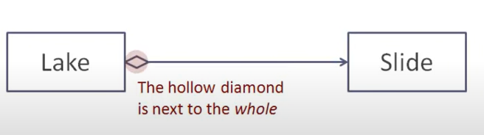
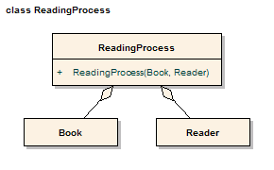
Association Relationships
We can model objects that contain other objects by way of special associations called aggregations and compositions.
An aggregation specifies a whole-part relationship between an aggregate (a whole) and a constituent part, where the part can exist independently from the aggregate. Aggregations are denoted by a hollow-diamond adornment on the association.

Slide 19







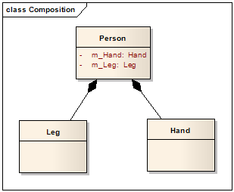
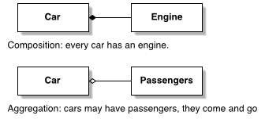
Association Relationships
A composition indicates a strong ownership and coincident lifetime of parts by the whole (i.e., they live and die as a whole). Compositions are denoted by a filled-diamond adornment on the association.
Window
Scrollbar
1
1
Titlebar
1
1
Menu
1
1 ..
*

Slide 20
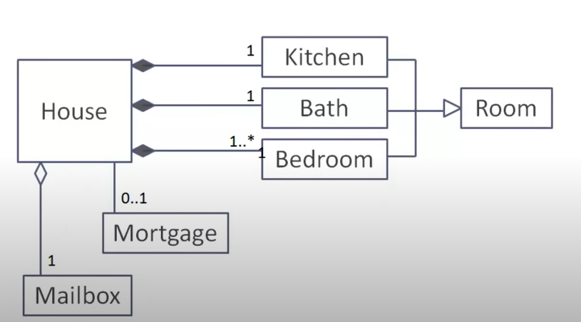
Example:

Slide 21
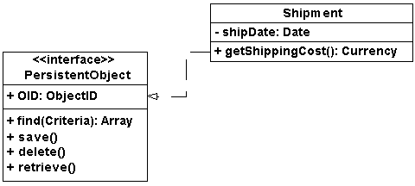
Interfaces
An interface is a named set of operations that specifies the behavior of objects without showing their inner structure. It can be rendered in the model by a one- or two- compartment rectangle, with the stereotype
<<interface>> above the interface name.
<<interface>> ControlPanel

Slide 22



Interface Services
<<interface>>
ControlPanel
Interfaces do not get instantiated. They have no attributes or state. Rather, they specify the services offered by a related class.

Slide 23











Interface Realization Relationship
A realization relationship connects a class with an interface that supplies its behavioral specification. It is rendered by a dashed line with a hollow triangle towards the specifier.
<<interface>> Printer
specifier
<<interface>>
Paser
<<interface>> Paser
implementation
Print Setup
HTML Parser
JSON Parser

Slide 24
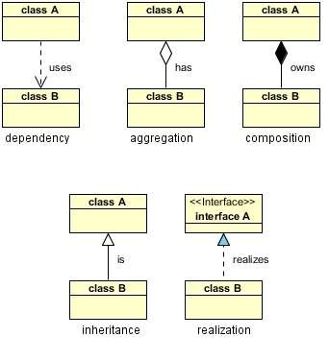
Relationships in Nutshell
Dependency : class A uses class B
Aggregation : class A has a class B
Composition : class A owns a class B
Inheritance : class B is a Class A (or class A is extended by class B)
Realization : class B realizes Class A (or class A is realized by class B)

Slide 25
Dependency
 Dependency is represented when a reference to one class is passed in as a method parameter to another class. For example, an instance of class B is passed in to a method of class A:
public class A {
public void doSomething(B b) {

Slide 26
Aggregation
Now, if class A stored the reference to class B for later use we would have a different relationship called Aggregation.
public class A {
private B _b;
public void setB(B b) { _b = b; }

Slide 27
Composition
 Aggregation is the weaker form of object containment (one object contains other objects). The stronger form is called Composition. In Composition the containing object is responsible for the creation and life cycle of the contained object (either directly or indirectly). Following are a few examples of Composition. First, via member initialization:
public class A {
private B _b = new B();}
public class A {
private B _b;
public A() {
_b = new B();
} // default constructor

Slide 28
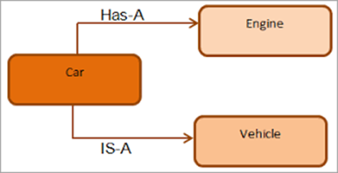
Inheritance
public class Vehicle{
...
} // class Vehicle
public class Car extends Vehicle{
....
} // class Car

Slide 29
Realization
1public interface A { 2
3 ...
4
5} // interface A 6
7public class B implements A { 8
9 ...
10
11} // class B

Slide 30












Parameterized Class
A parameterized class or template
defines a family of potential elements.
To use it, the parameter must be bound.
T
LinkedList
T
1 .. *
A template is rendered by a small dashed rectangle superimposed on the upper-right corner of the class rectangle. The dashed rectangle contains a list of formal parameters for the class.

Slide 31
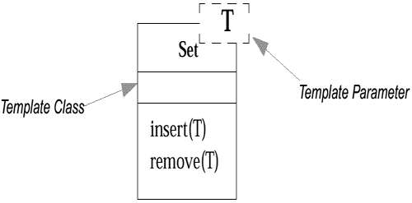







Example : Parameterized Class
class Set <T> {
void insert (T newElement);
void remove (T anElement);

Slide 32







Parameterized Class (Cont’d)
Some object-oriented languages such as C++ and Ada support the concept of parametrized classes.
They are most commonly used for the element type of collection classes, such as the elements of lists.
For example, in Java, suppose that a Board software object holds a List of many Squares. And, the concrete class that implements the List interface is
an ArrayList:
public class Board
{
private List<Square> squares = new ArrayList<Square>();
// …
}

Slide 33



Parameterized Class (Cont’d)
T
Binding is done with the <<bind>> stereotype and a parameter to supply to the template. These are adornments to the dashed arrow denoting the realization relationship.
Here we create a linked-list of names for
the Students List.
LinkedList
T
1..*
<<bind>>(Name)
StudentList

Slide 34




Enumeration
An enumeration is a user-defined data type that consists of a name and an ordered list of enumeration literals.
<<enumeration>> Boolean
false true

Slide 35














Exceptions
<<exception>>
Exception
Exceptions can be modeled just like any other class.
Notice the <<exception>> stereotype in the name compartment.
getMessage() printStackTrace()
<<exception>>
InterfaceException
<<exception>>
SQLException

